Slide 1



Admin Training
Change Management

Slide 2
Learning Objectives Change Management
Teach
(Slides)
Show
(Demo)
Do
(Exercises)
Review
(Q&A)
Change Management Overview
Structure of a Revisioning Workspace
Lifecycle Editor
Releasing a Change Order
Released & Non-Released Statuses in Rev-Controlled Workspace
BOM Compare

Slide 3
1 – Change Management Overview

Slide 4
Change Management Overview
Engineering Change Management provides a repeatable request, review, analysis, and change implementation process that is flexible for a number of typical engineering-related changes.
An Engineering Change Order (ECO) in Autodesk Fusion Lifecycle captures the process of releasing a part or a BOM for production
ECO process documents the changes made to a BOM
ECOs can also help manage Tasks to be completed by assigned Change Teams at certain points in the workflow process (Pre-Quote, Implementation)
ECOs contain history of specific approvals during the workflow process (CCB, Quoting etc.)

Slide 5
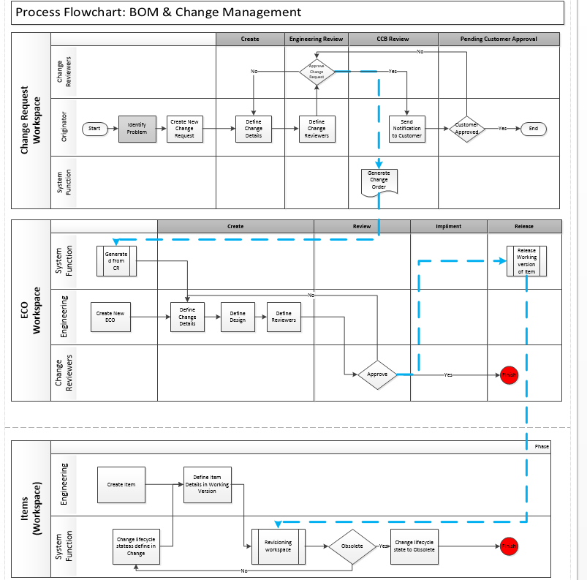
Change Management Process in Fusion Lifecycle

Slide 6

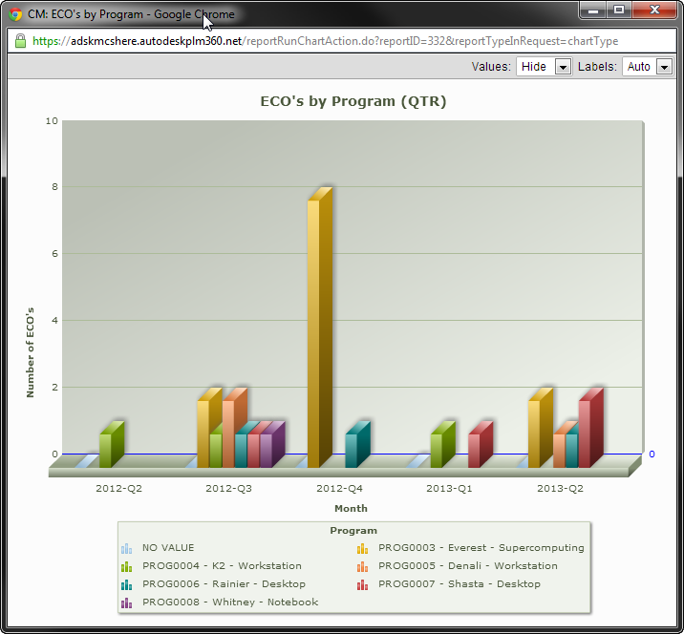
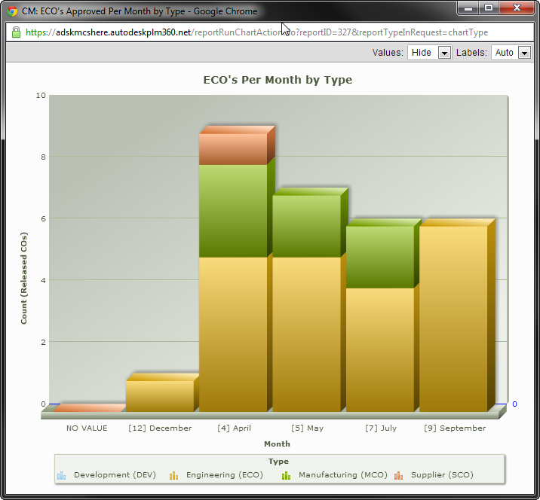
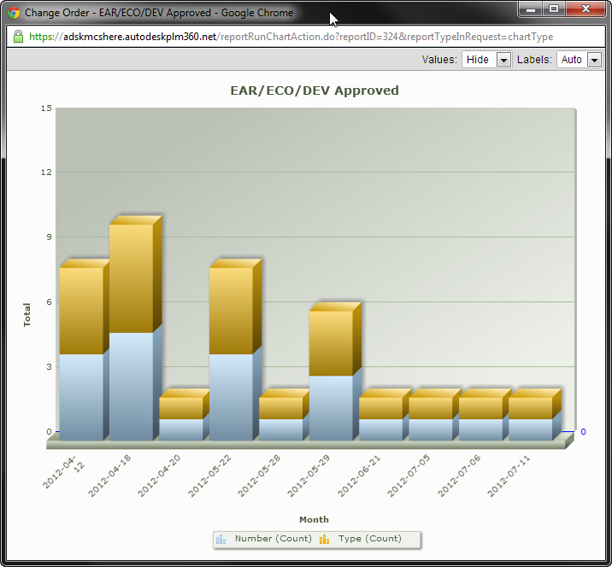
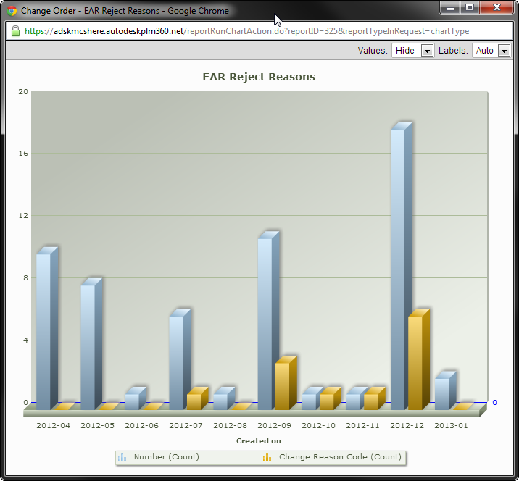
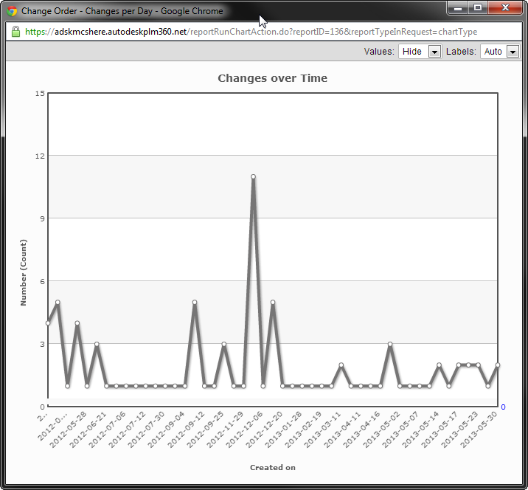
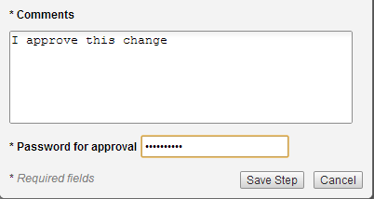
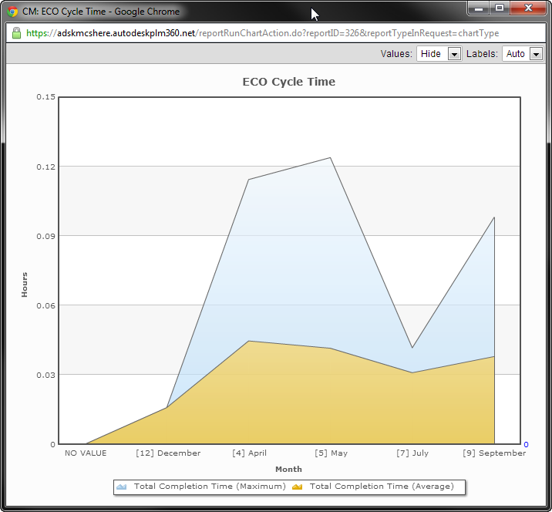
Change Management Features
Fully Configurable Workflows
Approval Process Tracking
Fully Configurable Approval Routings
Automatic Notifications
Supplier & Customer Participations
To-Do Lists
Configurable Reports
Digital Signatures

Slide 7
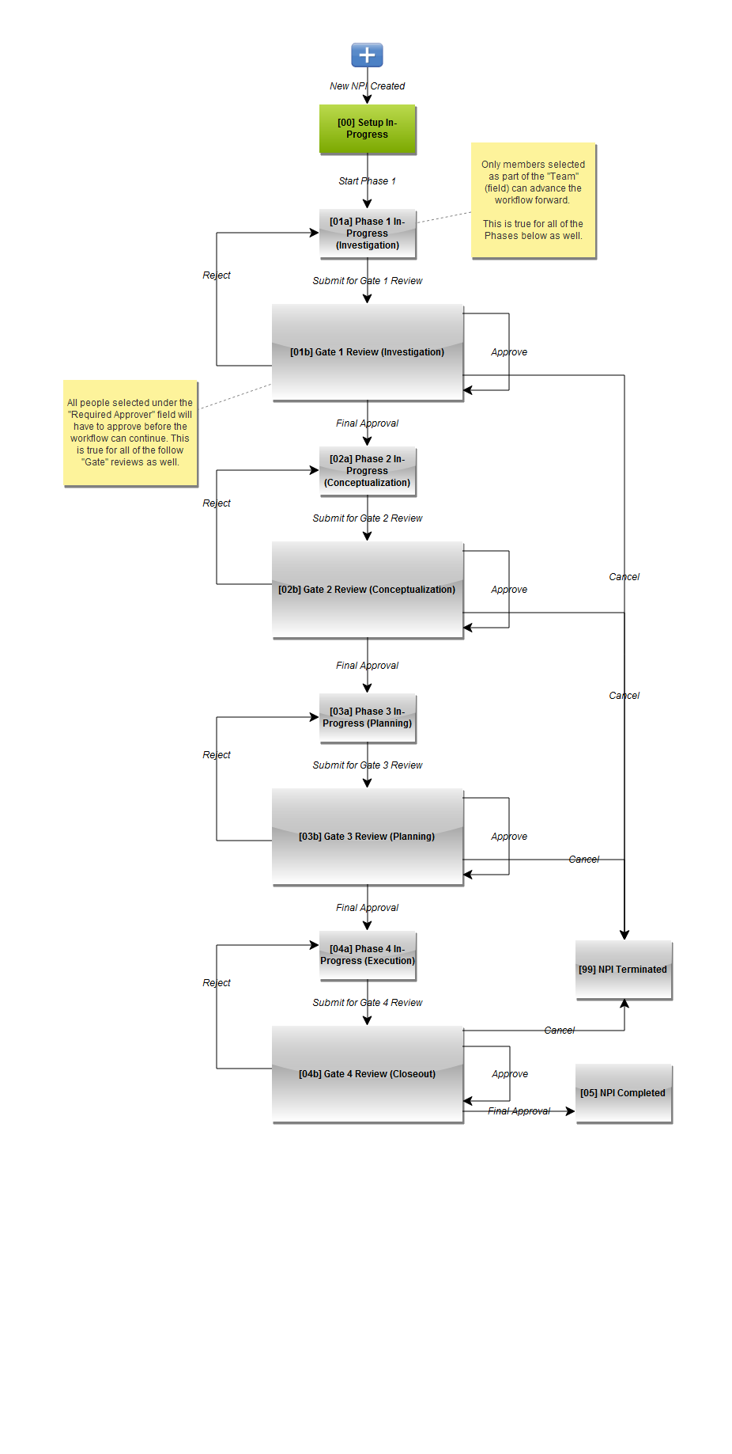
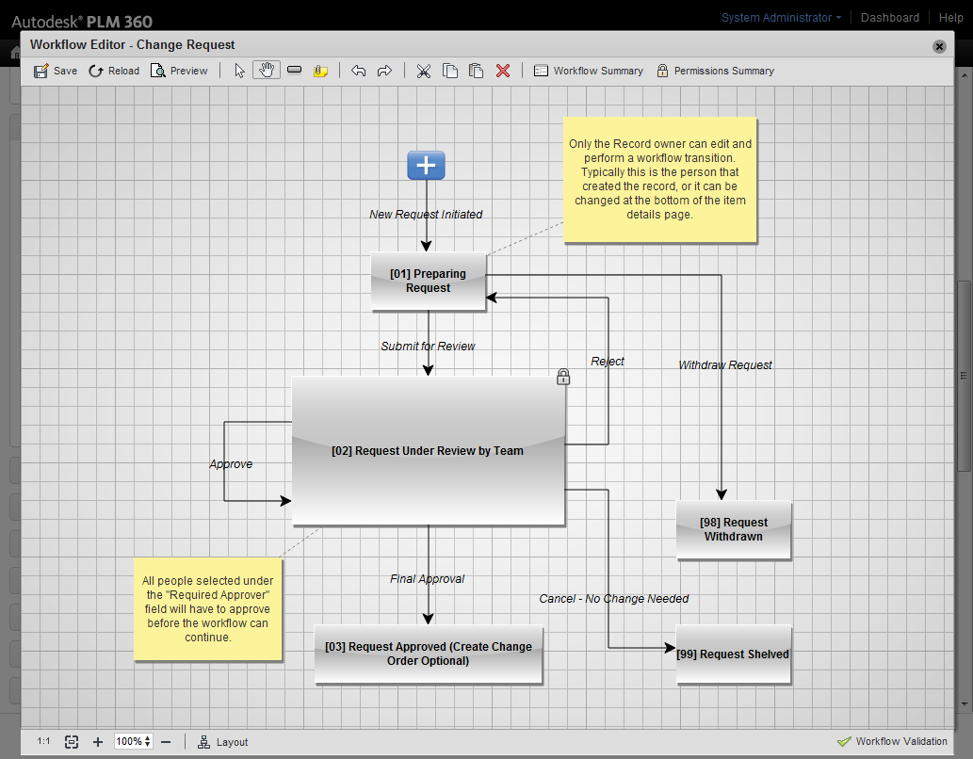
Workflow
Workflow refers to the process of moving an item through a pre-defined set of states. As people finish their tasks, they transition the item to the next state.
Workflow Tools include:
Permissions on who can do what when
Tracking (who signed off and when)
Item state access for filtering/reporting
Automated notifications on actions
Emails – on task assignment
In product Dashboard – my open tasks
Automated notifications on entering/leaving states
Automation (via the scripting engine)
Promotion of lifecycle events
To be continued...

Slide 8
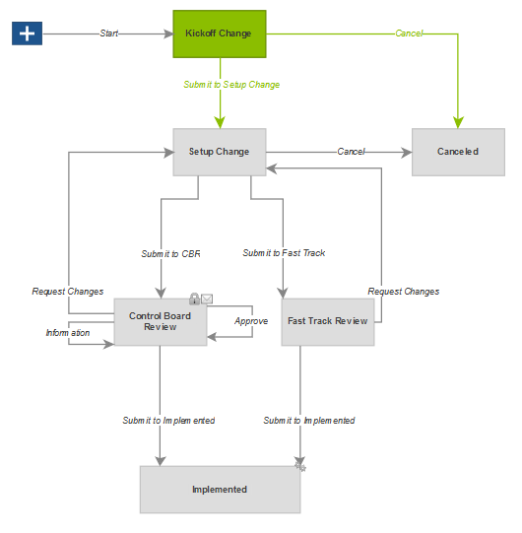
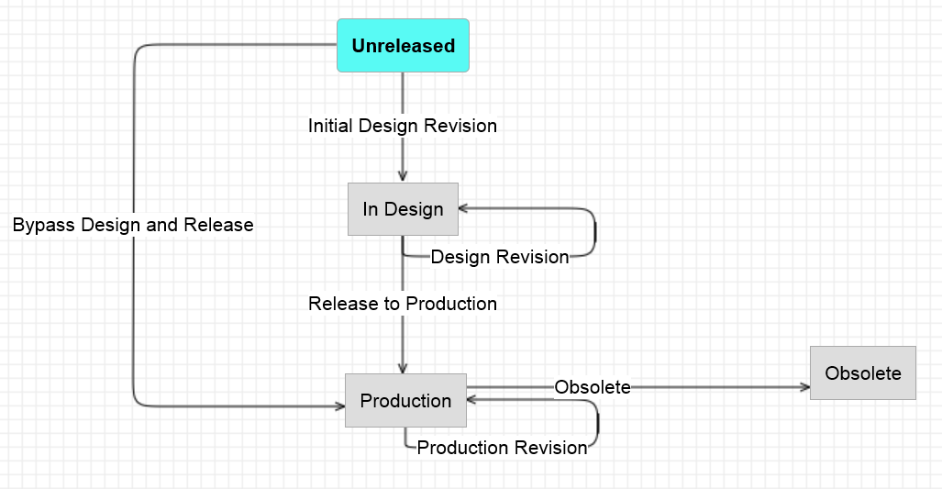
Revisioning & Rev-Controlled Workspaces
Change Management utilizes a Revisioning Workspace, Ex. ECO
Revisioning items progress through Workflow states
This acts on a Revision-Controlled Workspace, Ex. Items and BOMs
Revision-Controlled items are moved through Lifecycles by revisioning items

Slide 9
2 – Structure of a Revisioning Workspace

Slide 10
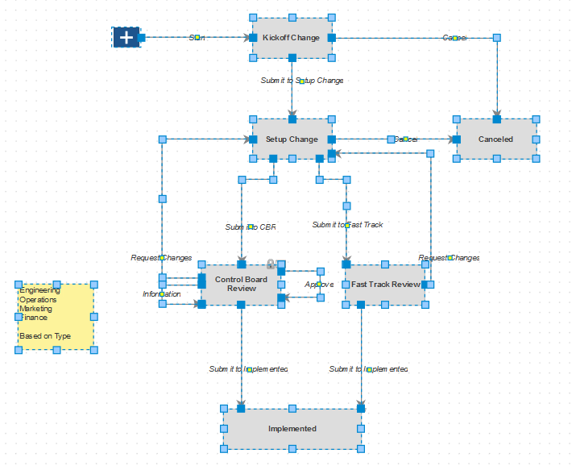
Workflow Copy & Paste
Select All and Copy in Source Workflow
Paste into Target Workflow
Important! Open each transition and assign the unique general permission for the target workspace

Slide 11
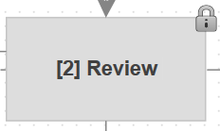
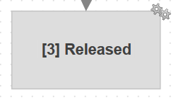
Locked State and Managed State
Locked State: The state in the workflow where the item is locked and can no longer be edited, even if the user has the required permissions (the change window is closed).
Managed State: The state in the workflow where the affected items are transitioned to the next phase of the lifecycle defined for each item, and the change window is closed.

Slide 12
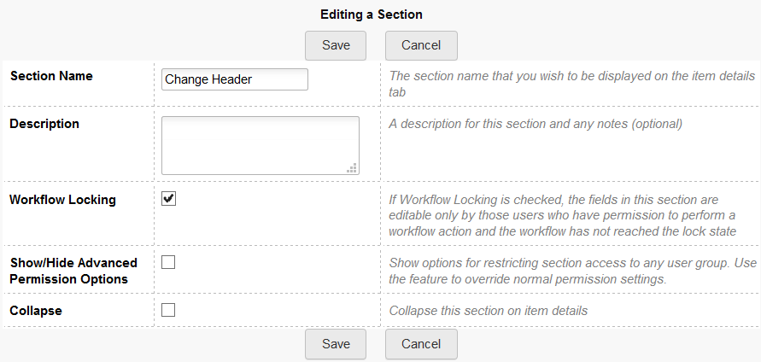
Workflow Locking of Sections
Applies to Sections on the Revisioning Workspace’s Item Details tab
Place checkmark in Workflow Locking for each of the above sections
Workflow Locking: If Workflow Locking is checked, the fields in this section are editable only by those users who have permission to perform a workflow action and the workflow has not reached the lock state

Slide 13
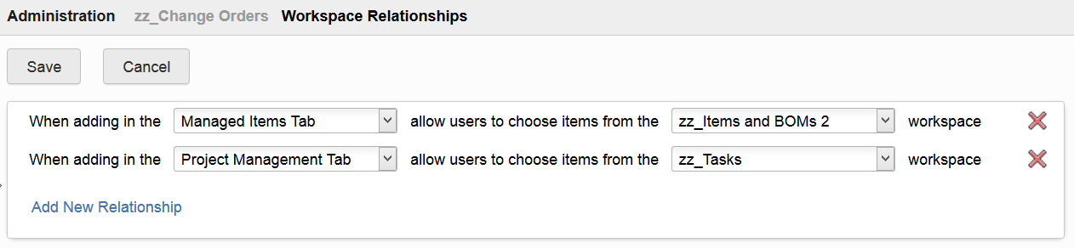
Relationship to Rev-Controlled Workspace
Needed to direct from whence to pull Affected Items
Set up in Workspace Manager
Go to Workspace Relationships link
Specify for the Managed Items Tab

Slide 14
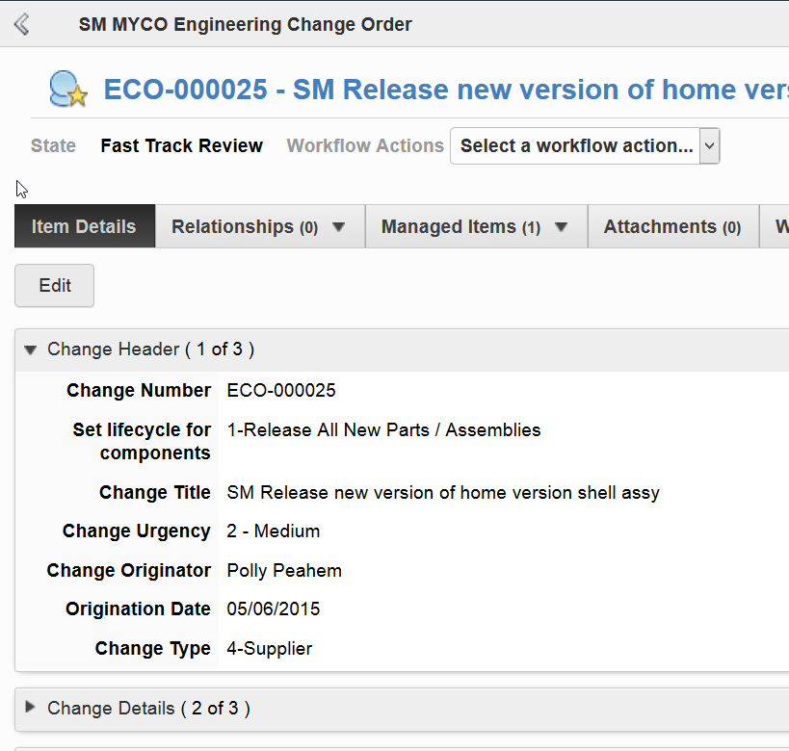
Teach
(Slides)
Show
(Demo)
Do
(Exercises)
Review
(Q&A)
Demo Topics Change Management
Change Management
Overview
Structure of a Revisioning Workspace
Workflow Copy & Paste
Locked State and Managed State
Workflow Locking of Sections
Relationship to Rev-Controlled Workspace

Slide 15
Exercises 1 - 5
Teach
(Slides)
Show
(Demo)
Do
(Exercises)
Review
(Q&A)

Slide 16
3 – Lifecycle Editor

Slide 17
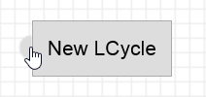
Lifecycle Editor
Auto Save
One administrator at a time
Select desired transitions for target Revisioning Workspace
To add a new transition, hover over a Lifecycle until the half-circle appears, then drag to another Lifecycle

Slide 18
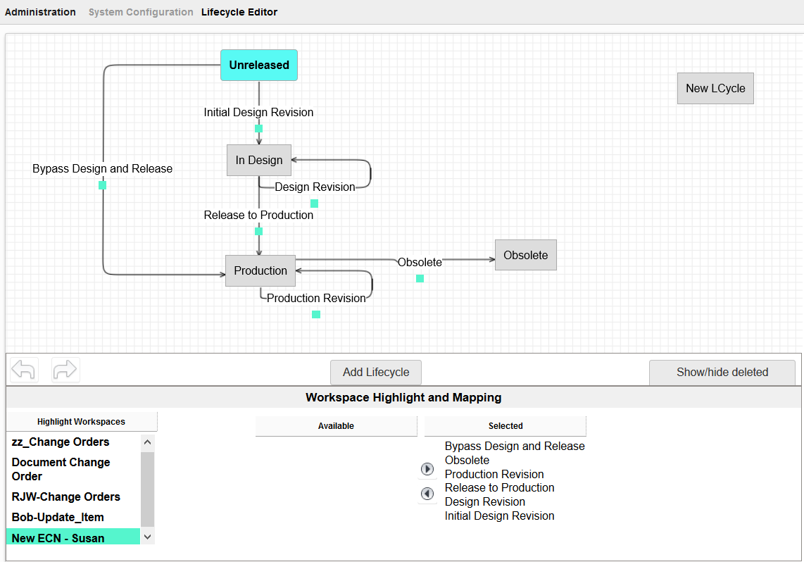
Teach
(Slides)
Show
(Demo)
Do
(Exercises)
Review
(Q&A)
Demo Topics Change Management
Lifecycle Editor

Slide 19
Exercise 6
Teach
(Slides)
Show
(Demo)
Do
(Exercises)
Review
(Q&A)

Slide 20
4 – Releasing a Change Order

Slide 21
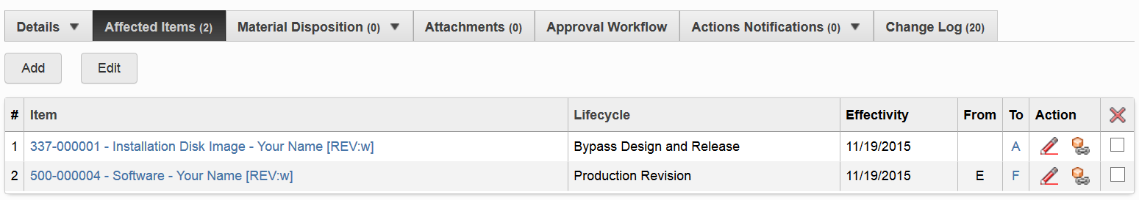
Affected Items
Sometimes called “Managed Items”
The items and/or BOMs that will be revisioned
Locked out from any other Change Orders once added to one Change Order
Revision is automatically incremented
“Add related items” feature

Slide 22
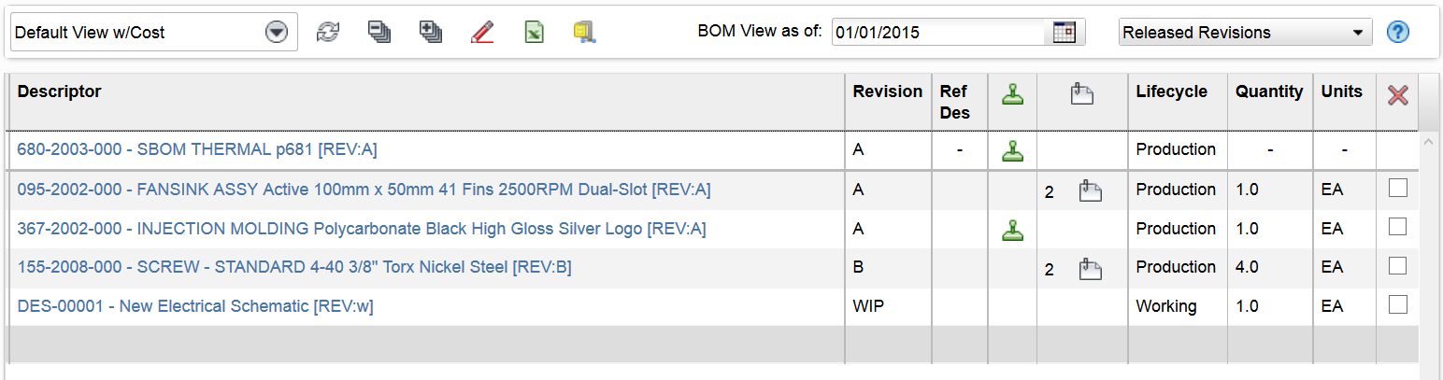
Effectivity
BOM configuration is based on item Effectivity date
Set on Affected Items tab in Change Order
Standard PLM functionality

Slide 23
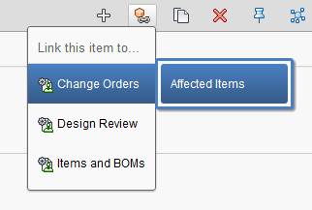
Efficiency in Change Creation
Create a Change Order and add to its Affected Item tab directly from an item that needs changed
Use the “Create Relationships” button

Slide 24
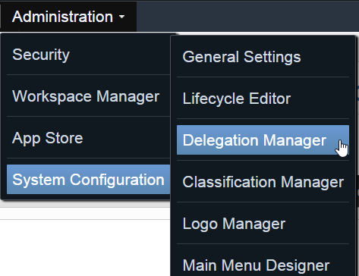
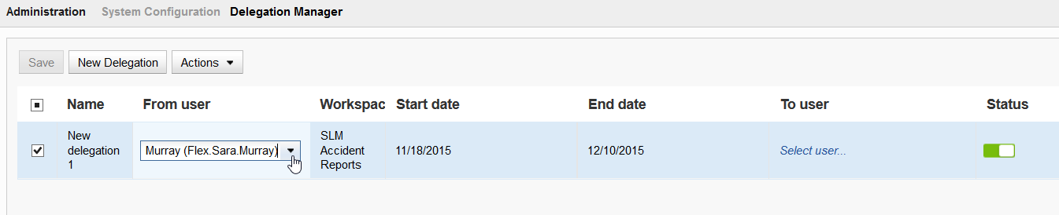
Delegation Manager
Set up delegations for other users
Workflow history shows one user “On behalf of” other user
Tips
Double-click to pop open the drop down lists
Turn an existing delegation off or on simply by clicking on the Status switch
“Set” the new delegation by clicking off of it, then click the Save button
Even after saving, you will be asked if you want to leave page; yes it’s OK

Slide 25
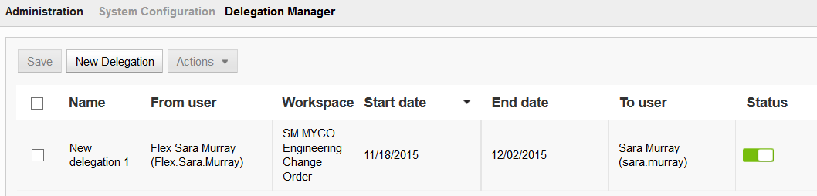
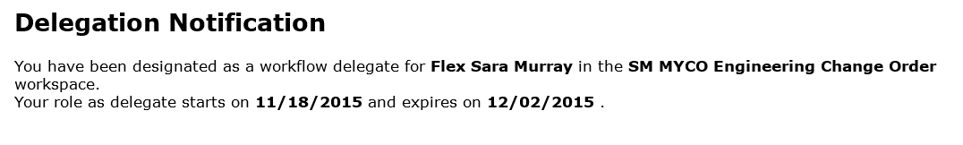
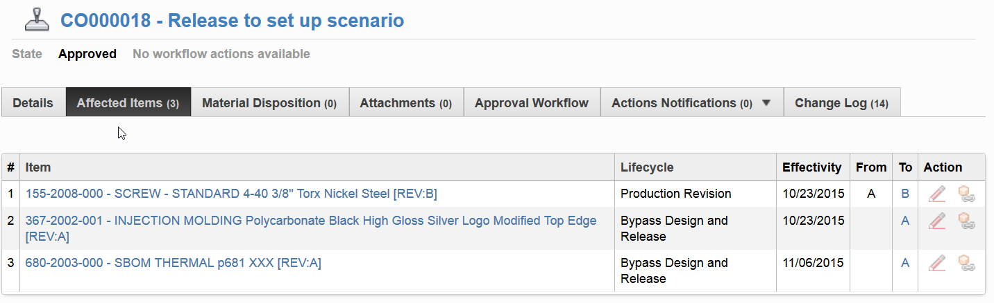
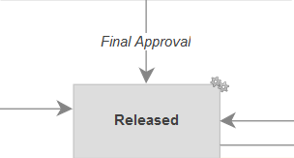
Teach
(Slides)
Show
(Demo)
Do
(Exercises)
Review
(Q&A)
Demo Topics Change Management
Releasing a Change Order
Create a Change Order
Add Affected Items and fill Lifecycle & Effectivity
Efficiency in Change Creation
Route Change Order through workflow process
Delegation Manager

Slide 26
Exercises 7 - 9
Teach
(Slides)
Show
(Demo)
Do
(Exercises)
Review
(Q&A)

Slide 27
5 – Released & Non-Released Statuses in Rev-Controlled Workspace

Slide 28
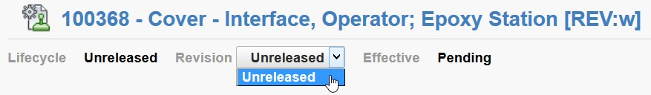
Unreleased Lifecycle
When an item is first created in Autodesk Fusion Lifecycle, it starts at a lifecycle called Unreleased with the first version (numbering starts at 1). The item has never been released, and there are no other revisions available in the revision pulldown for that item.
The revision identifier is a lowercase “w”.

Slide 29
Lifecycle Change
#1
Change Order hits its Managed State
#2
(Concurrently)
Affected Items change Lifecycle & receive new revision
A new working version of each Affected Item is created

Slide 30
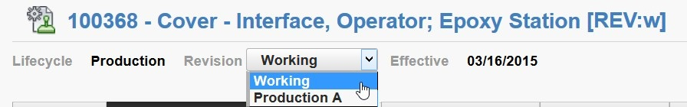
Working Version
A working version is a new record copied from the released item, and the working version is ready to be edited for the next change to that item—whenever that change may happen to occur. If you have rights to see working versions, you will see the released revision plus the working version available for viewing in the revision pulldown for that item.
The revision identifier is a lowercase “w”.

Slide 31

Revert Working Version
Once the working version has been updated such that it is different than the released item, you will see a “Revert” button that tells you changes have been made and where you can quickly cancel all changes made in all tabs of the working version since the last release.

Slide 32
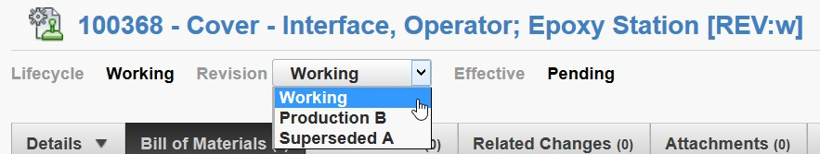
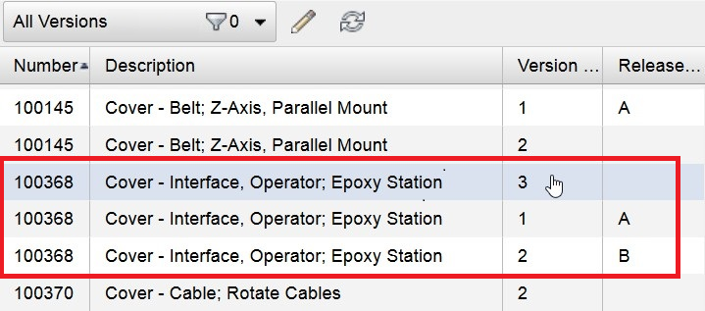
Working Version Number
Each working version has a version number that identifies it. Below, version 3 of part number 100368 is the current working version.

Slide 33
6 – BOM Compare

Slide 34
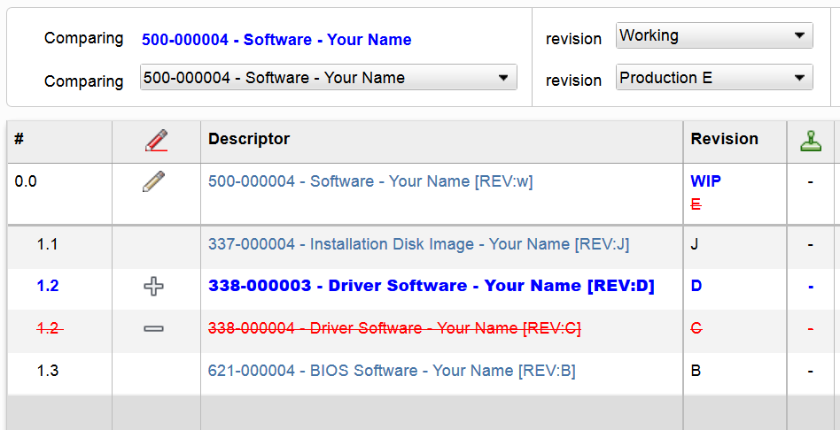
BOM Compare
Compare different revisions of a BOM, OR
Compare different BOMs

Slide 35
Teach
(Slides)
Show
(Demo)
Do
(Exercises)
Review
(Q&A)
Demo Topics Change Management
Released & Non-Released Statuses in Rev-Controlled Workspace
Working Version in Pulldown
Revert Working Version
Working Version Number (Item Viewer)
BOM Compare
Update BOM’s Working Version

Slide 36
Exercises 10 - 11
Teach
(Slides)
Show
(Demo)
Do
(Exercises)
Review
(Q&A)

Slide 37
Review Change Management
Teach
(Slides)
Show
(Demo)
Do
(Exercises)
Review
(Q&A)
Change Management Overview
Structure of a Revisioning Workspace
Lifecycle Editor
Releasing a Change Order
Released & Non-Released Statuses in Rev-Controlled Workspace
BOM Compare

